Slide 1
Agenda for GEOG260/360 GIS & Land Change Models
November 1
Get instructions for Project Proposal
Does anyone want to present an idea on Monday to recruit partners?
November 6
Discuss Project Proposals
November 8
Submit Project Proposal by 4pm on Canvas
November 13
Feedback on Proposals
November 15 Deadline for abstracts submitted to https://www.aag.org/events/aag2024/
Chapter 12
November 20
In Class Exam
November 27 to December 11, which is the last day to withdraw from the course
Project Presentations
December 18 during Final Exam time slot 6:30-8:30pm
Make-up project presentation time slot in case a project presentation must be postponed
December 13
Project PPTX file due
December 20
Project Product due

Slide 2
Proposal Requirement
Read the syllabus concerning the course project. Each group consists of between two and five people. One person from each group submits exactly one Word document of exactly one page that specifies the following:
The names of the members of the group.
Whether the project will serve as a capstone requirement for a group member.
The title of the project.
The deliverable product, including how the product will make a difference to an audience outside our class.
A paragraph explaining the idea, including the methods and sources of data.

Slide 3
Ideas for projects
Make a report to Tammy Woodard concerning glitches and fixes for TerrSet.
Show how to make an extrapolation of both gross gain and gross loss that involves Alternation through various stages using a dynamic variable of distance to edge between presence and absence of temporary crop. Work with the the Long Term Ecological Research (LTER) data. Work with Thomas Bilintoh to make a video linked to a Wikipedia site concerning the concepts in one of his dissertation chapters. Read Thomas Bilintoh’s dissertation chapter 1, which concerns the use of TOC to explain a category that alternates during a time series. Make a poster to present this spring to the annual PIE-LTER meeting. Data are on Canvas.
Do something similar to the previous but using the data for the temporary crop in Bahia, Brazil, which is on the class file share. Explain the strange patterns in the maps at the 30-meter resolution for temporary crops. Join Wednesday zoom meetings. Make a video linked to a Wikipedia site on at least one of these ideas. This relates to the topic of Tanner’s honors thesis.

Slide 4
Use the Assignments’ data to show TerrSet glitches and recommended fixes. Send the report to Tammy Woodard.
Improve LCM’s Validation map to show a more informative legend similar to one of the assignments.
Check Group All for some algorithms,
REGRESS output should say what the mask is
REGRESS seems to be working inconsistently.
We found some strange things with Decision Forest in Assignment 6.
Group none is odd.
Decision forest created transition output maps that were mostly black.
Run CA-Markov to show how the quantity changes depending on the spatial filter that is supposed to modify only the spatial allocation.

Slide 5
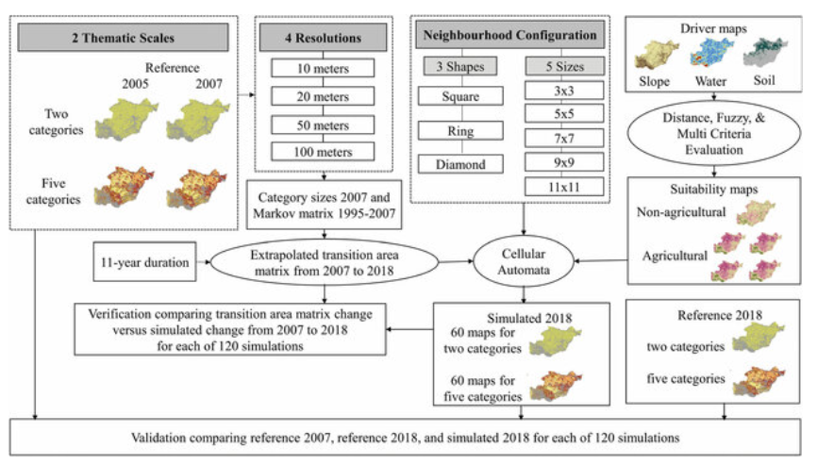
Flow diagram for an application of TerrSet’s CA-Markov model

Slide 6
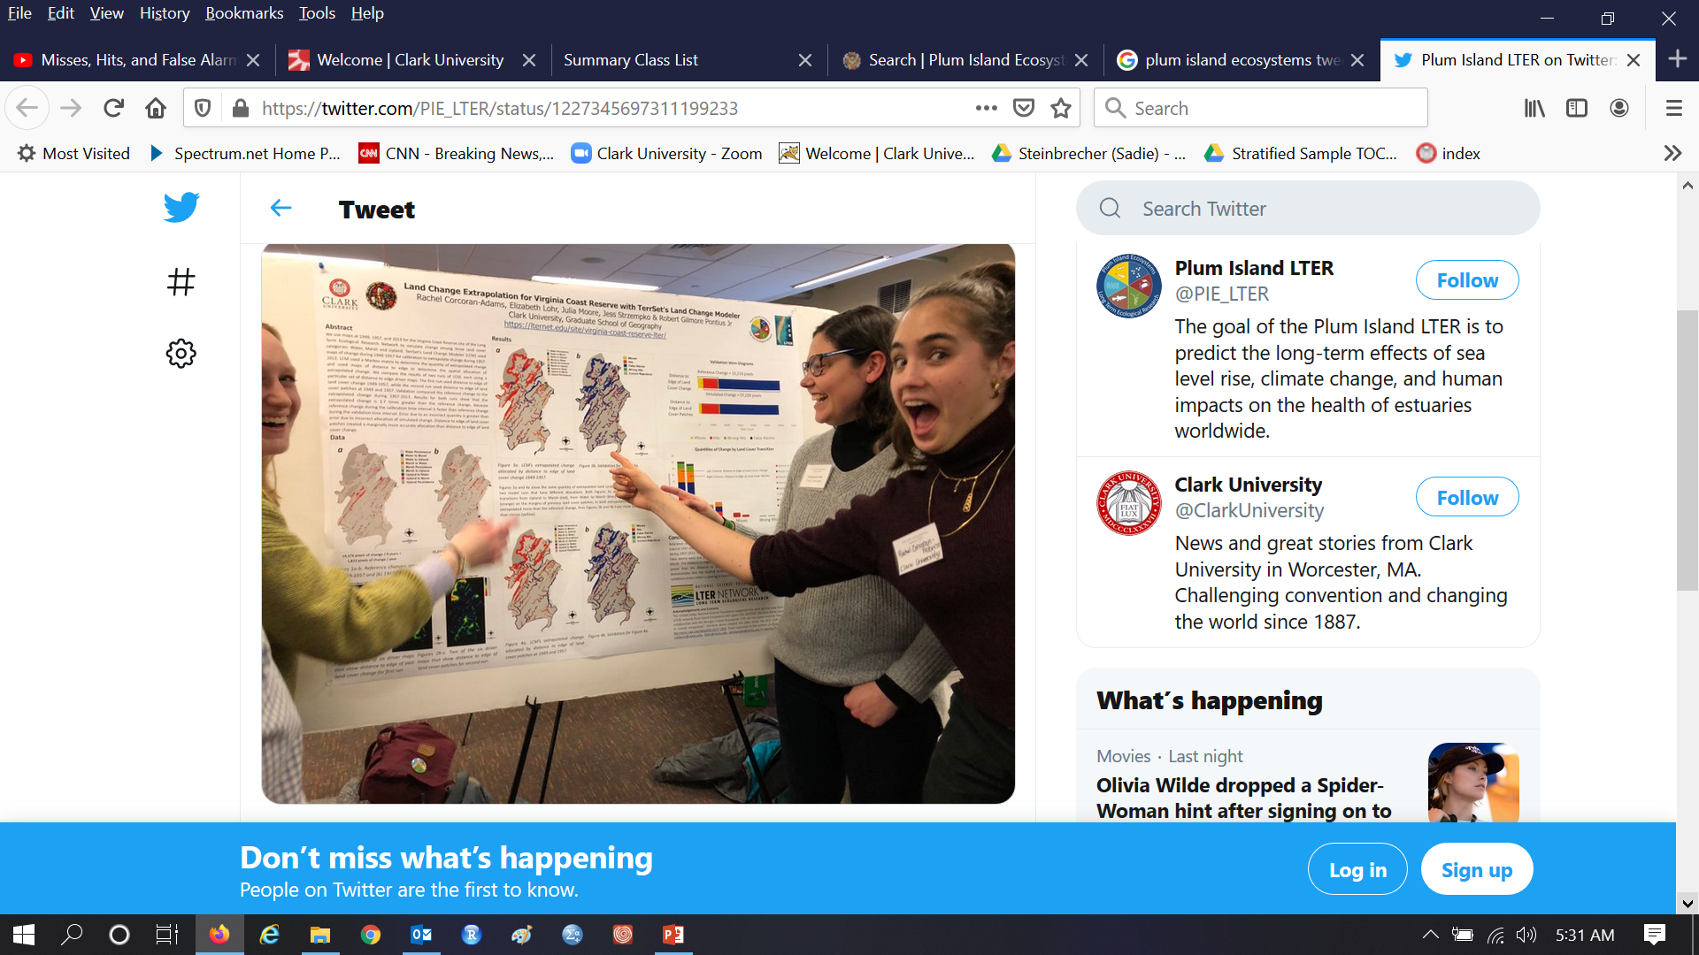
Students present posters at a meeting of the Plum Island Ecosystems Long Term Ecological Research site funded by the National Science Foundation

Slide 7
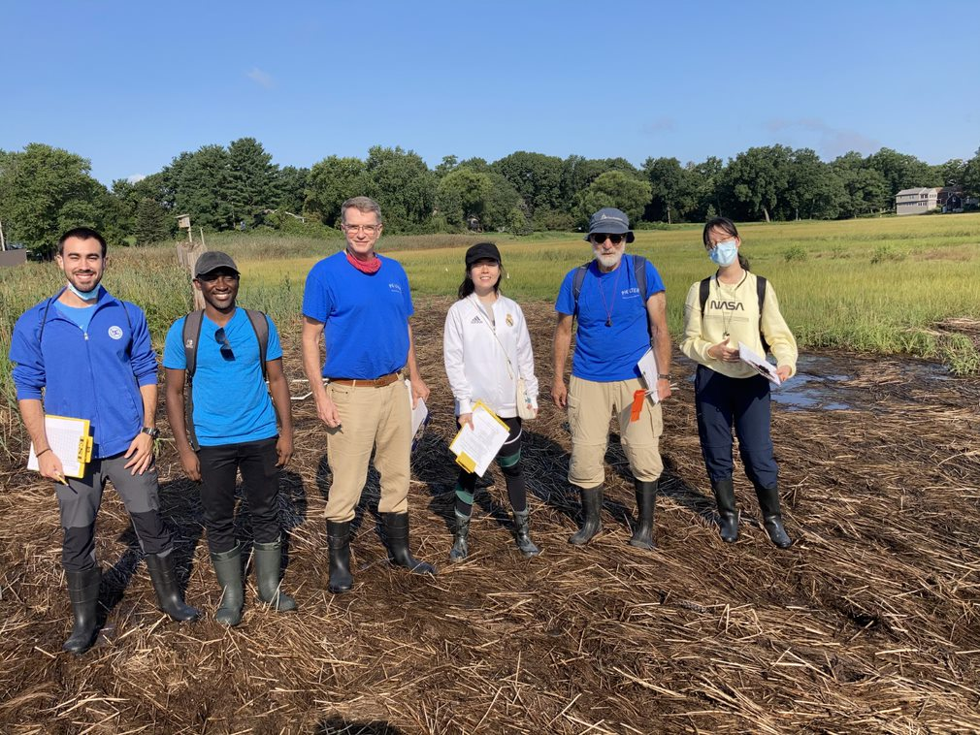
Doctoral Research Assistants are Thomas Bilintoh (second from left) and Aiyin Zhang (far right)

Slide 8
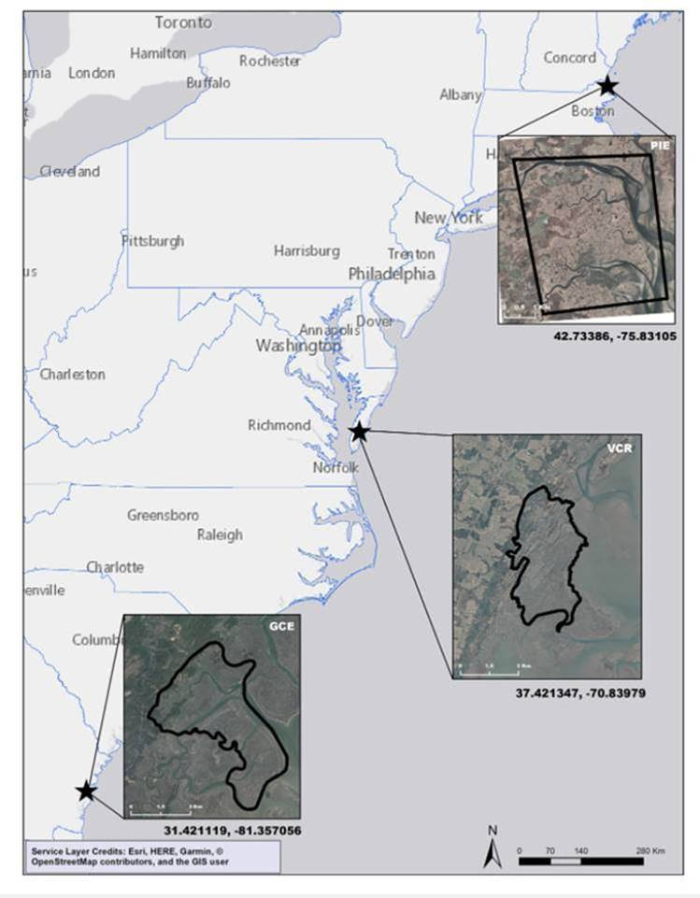
Three coastal sites of the Long Term Ecological Research Network

Slide 9
Georgia Coastal Ecosystems

Slide 10
Georgia Coastal Ecosystems

Slide 11
Georgia Coastal Ecosystems

Slide 12
Virginia Coastal Reserve

Slide 13
Virginia Coastal Reserve

Slide 14
Virginia Coastal Reserve

Slide 15
Plum Island Ecosystems

Slide 16
Plum Island Ecosystems

Slide 17
Plum Island Ecosystems

Slide 18
Plum Island Ecosystems (PIE) version 01 has four categories

Slide 19
Plum Island Ecosystems (PIE) version 01 has four categories

Slide 20
PIE

Slide 21
Plum Island Ecosystems

Slide 22
Georgia Coastal Ecosystems

Slide 23
Virginia Coast Reserve

Slide 24
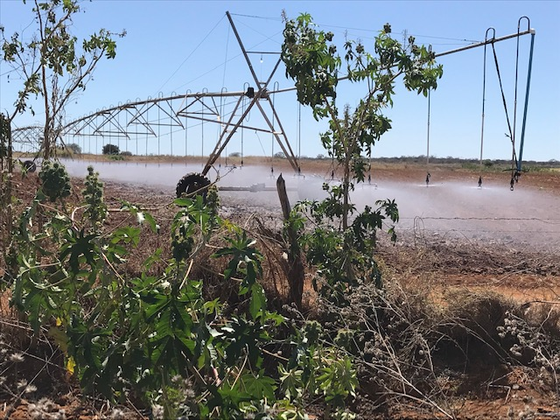
Clark Professors Pontius and Oliveria earned a $750,000 grant from NASA to study irrigation in Brazil as an adaption to climate change.

Slide 25
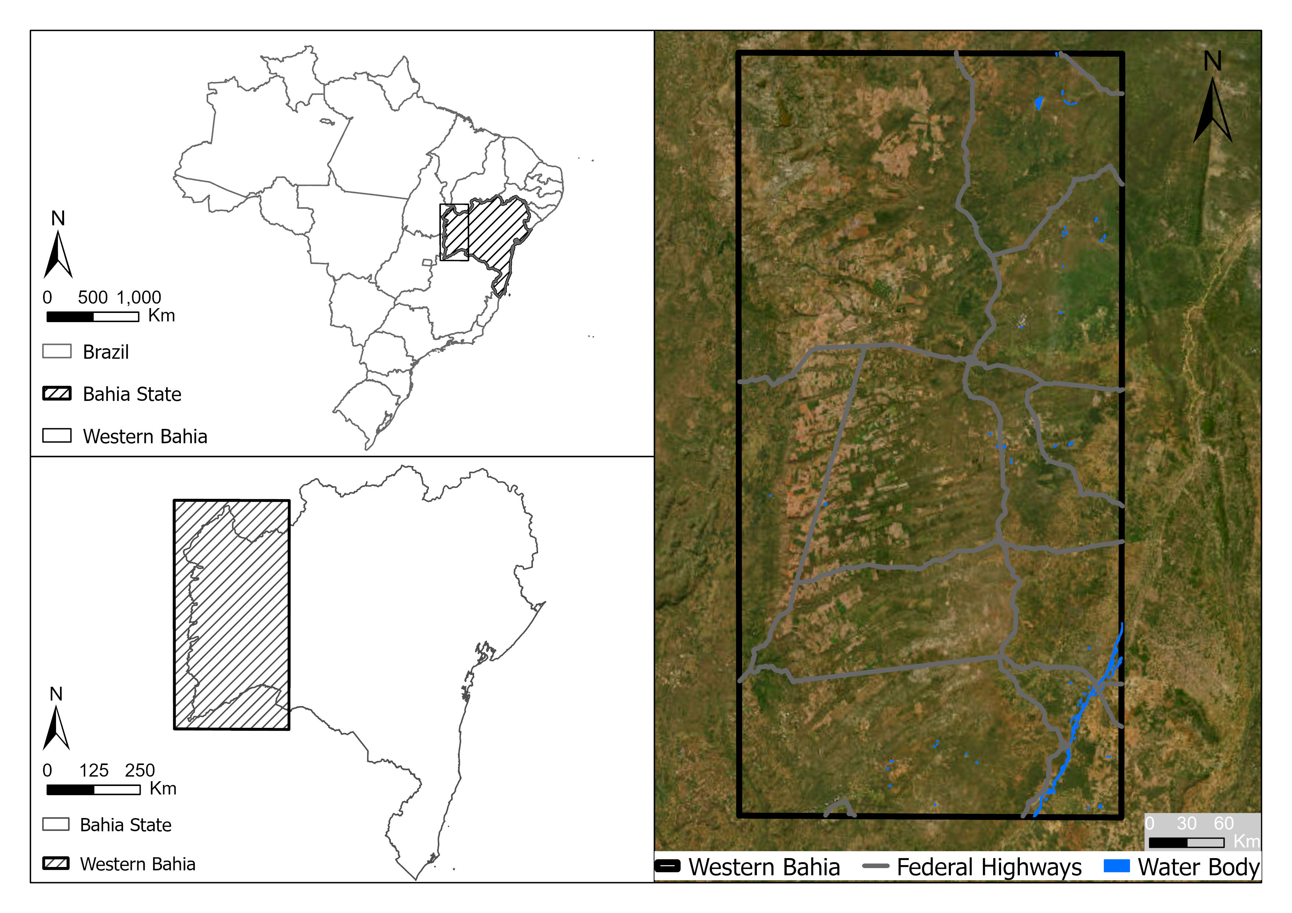
Western Bahia is a hotspot for soybean cultivation.
Pontius Jr, Robert Gilmore, Thomas Bilintoh, Gustavo de L. T. Oliveira, Julia Z. Shimbo. 2023. Trajectories of losses and gains of soybean cultivation during multiple time intervals in western bahia, BRAZIL. Space Week Nordeste. Fortaleza, Brazil.

Slide 26
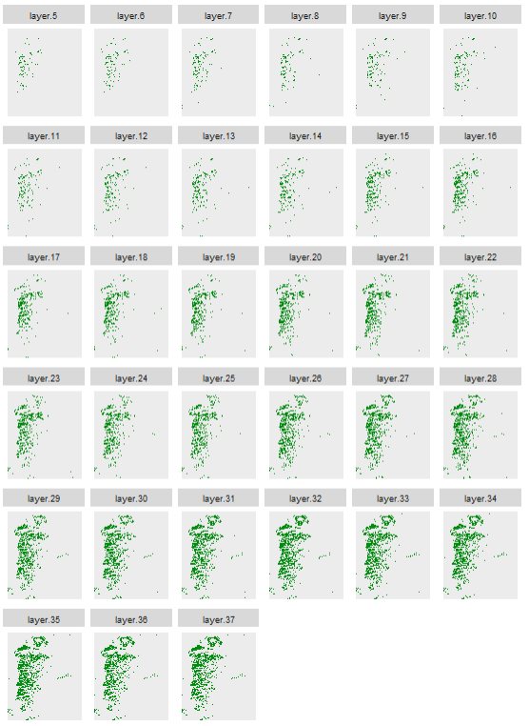
Maps show soybean in western Bahia at 33 years forming 32 time intervals.
Each pixel has more than 8 billion possible combinations of presence or absence of soybean across the 33 years.
2³³ = 8.6 X 10⁹
The challenge is to design graphics so that we can see important patterns and ignore relatively less important patterns.
1989
1990
1991
1992
1993
1994
1995
1996
1997
1998
1999
2000
2001
2002
2003
2004
2005
2006
2007
2008
2009
2010
2011
2012
2013
2014
2015
2016
2017
2018
Presence of soybean
Absence of soybean
2019
2020
2021

